Slide 1
DATA SCIENCE class XIV: support vector machines

Slide 2
agenda
Interview question
Exit ticket questions
Presentations
Support Vector Machines
Kernel’s and non-linear SVM
Lab

Slide 3
Interview questions
What potential value might the individual principal components have in qualitatively understanding our data?

Slide 4
Exit ticket questions
Eigenvalues vs Eigenvectors
How would you compute factor loadings?
How many PCA components should you use?
What analysis would you do complement linear regression?

Slide 5
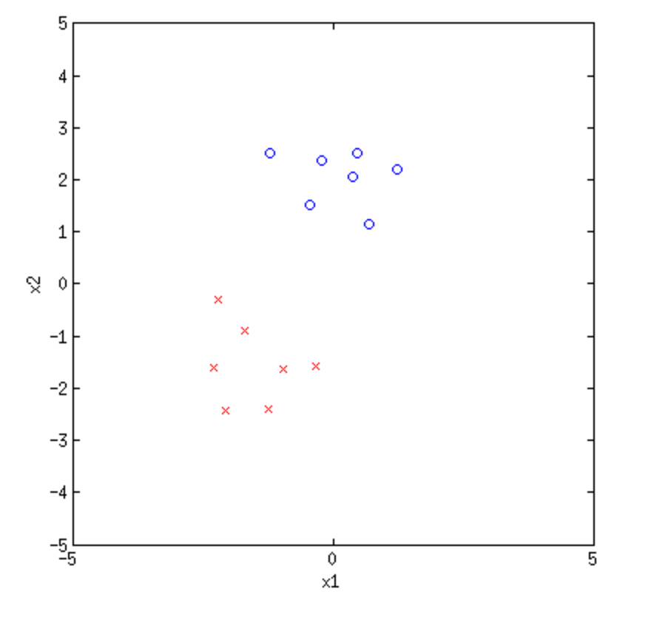
background
We may sometimes have data that is linearly separable.
This means we can draw a line between the points, and if you are one one side, you are class A, and on another side, class B.

Slide 6
background
We may sometimes have data that is linearly separable.
This means we can draw a line between the points, and if you are one one side, you are class A, and on another side, class B.

Slide 7
background
However, you might want to ask, what kind of line do you draw?

Slide 8
background
Margin is the distance from the line creating the decision boundary to the nearest point.

Slide 9
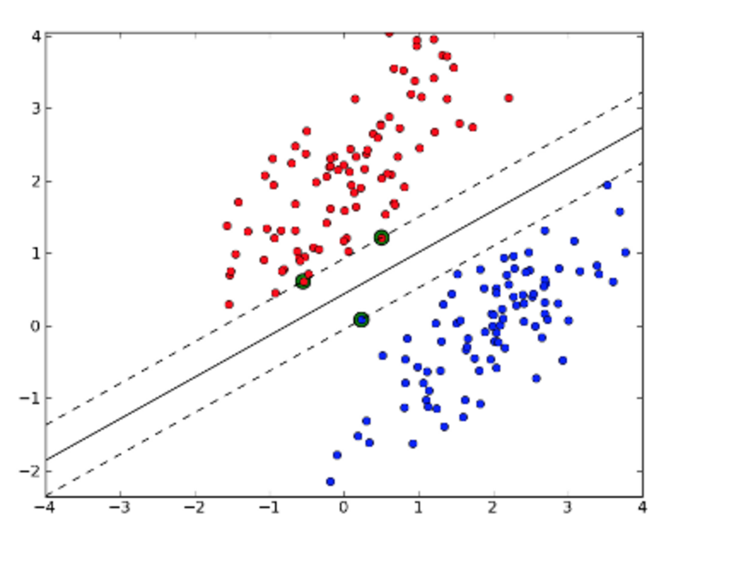
Support vector machines
Support vector machines find the line that maximizes the margin.
Support vectors – are the points closest to the optimal hyperplane.

Slide 10
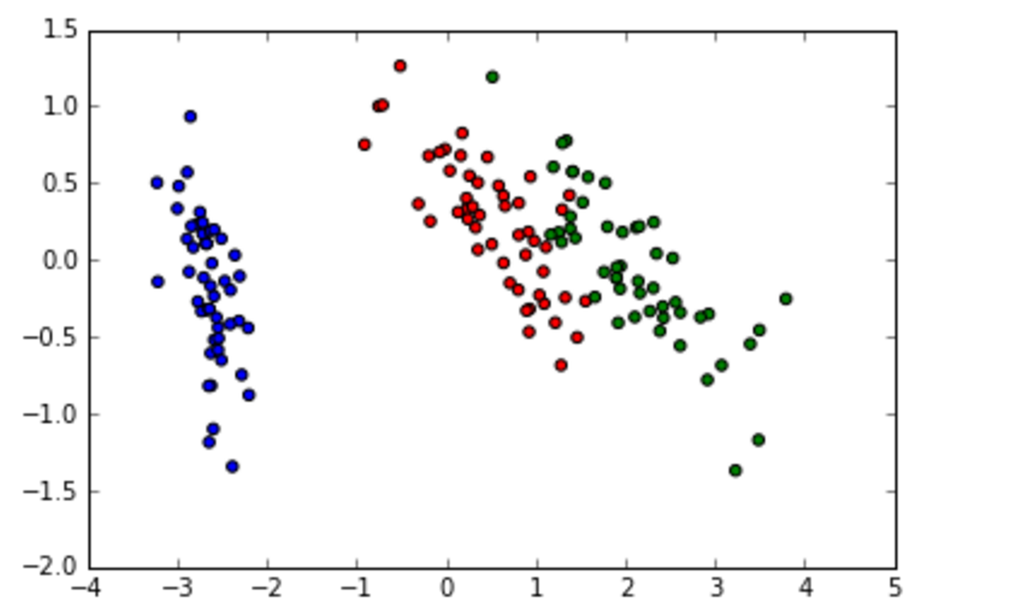
Support vector machines
Previously, we had a hard margin constraint: There could be no points on the wrong side of the margin.
But sometimes this happens!
If we want to allow data points on opposite
Sides of the margin, we call the constraint a soft
margin constraint.

Slide 11
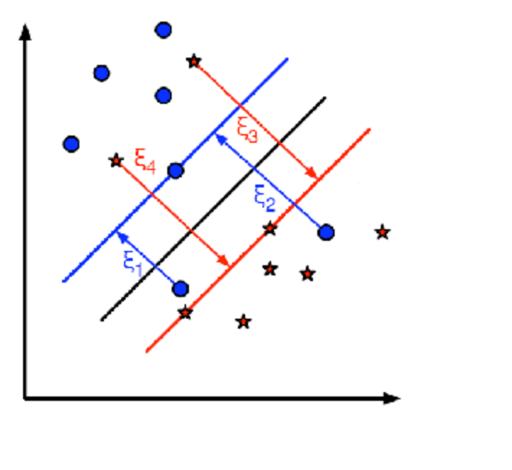
Support vector machines
In a soft margin constraint problem, you penalize any point on the wrong side by a certain amount (ξ) but still maximizing the margin.
You weigh those two against each other and fine a compromise.
You can give more or less weight to the errors terms penalty parameter C.

Slide 12
Multiclass svm
We can see that SVM’s divide data using a single line? What do you do if you have multiple classes?
One-versus-one – If you have K classes (let’s say 4), you create 4*(4-1)/2 =6 different classifiers where you train class 1 vs class 2, class 1 vs class 3, etc. You then run all the classifiers on the test datapoint, and most votes wins.
One-versus-rest – You create k classifiers, and train on that class as positive class, and everything else as negative class

Slide 13
Multiclass svm
Scikit’s SVC uses one-vs one, but scikit’s LinearSVC() uses one-vs-rest
Cons of various methods:
One-vs-one: Can also lead to multiple classifications, and may be difficult to compute with a large # of classes.
One-vs-rest: Problem is that training sets are misbalanced. There can also be cases where a point is classified into multiple classes

Slide 14
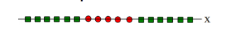
Non-linear svc
What if your data isn’t linearly separable. What do you do?
What if your data isn’t linearly separable. How do you draw a line through this and perfectly separate the points?

Slide 15
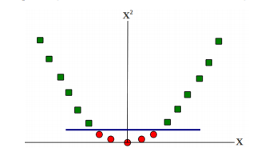
Non-linear svc
Solution: You actually increase the dimension of the points! You map them to a higher dimension.
http://www.cs.utah.edu/~piyush/teaching/15-9-print.pdf

Slide 16
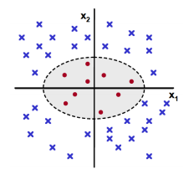
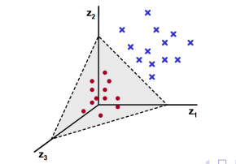
Non-linear svc
http://www.cs.utah.edu/~piyush/teaching/15-9-print.pdf

Slide 17
Non-linear svc
When you map a data point x from one dimension to another one, you use a feature space mapping function.
Ex: ϕ(x)=(x,x²). Ex ϕ(4)=(4, 16)
The kernel function is in some ways a similarity measures between two points in this new high dimensional space. You could write it as:
K(x,y) = ϕ(x)^{T}ϕ(y)

Slide 18
Non-linear svc
Ex: ϕ(x)=(x,x²)
K(x,y) = ϕ(x)^{T}ϕ(y)
If the feature mapping is chosen in the right way, the kernel might be really easy to calculate:
K(x,y) = ϕ(x)^{T}ϕ(y)=<something really simple>
Under the hood, instead of actually sending these data points to high dimension, it can use the easy kernel function calculation

Slide 19
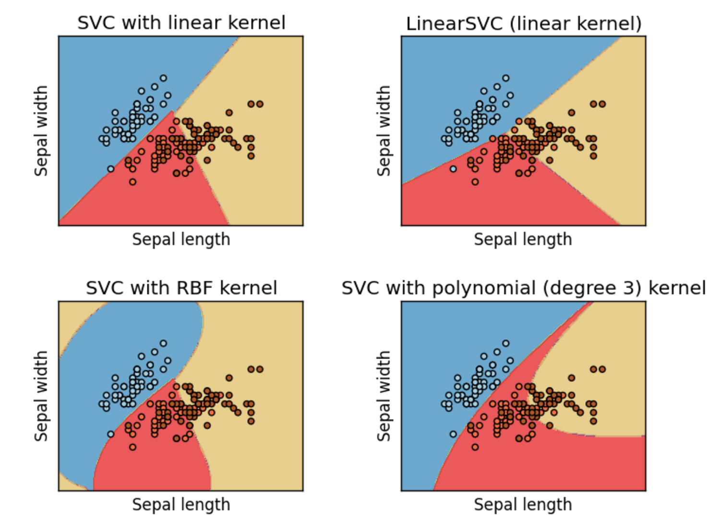
Types of kernels

Slide 20
Types of kernels
Common Kernel Types:
Linear – most basic kernel type
Radial basis function (rbf) – Assumes the distance between any two points is like the Gaussian distribution
Polynomial -

Slide 21
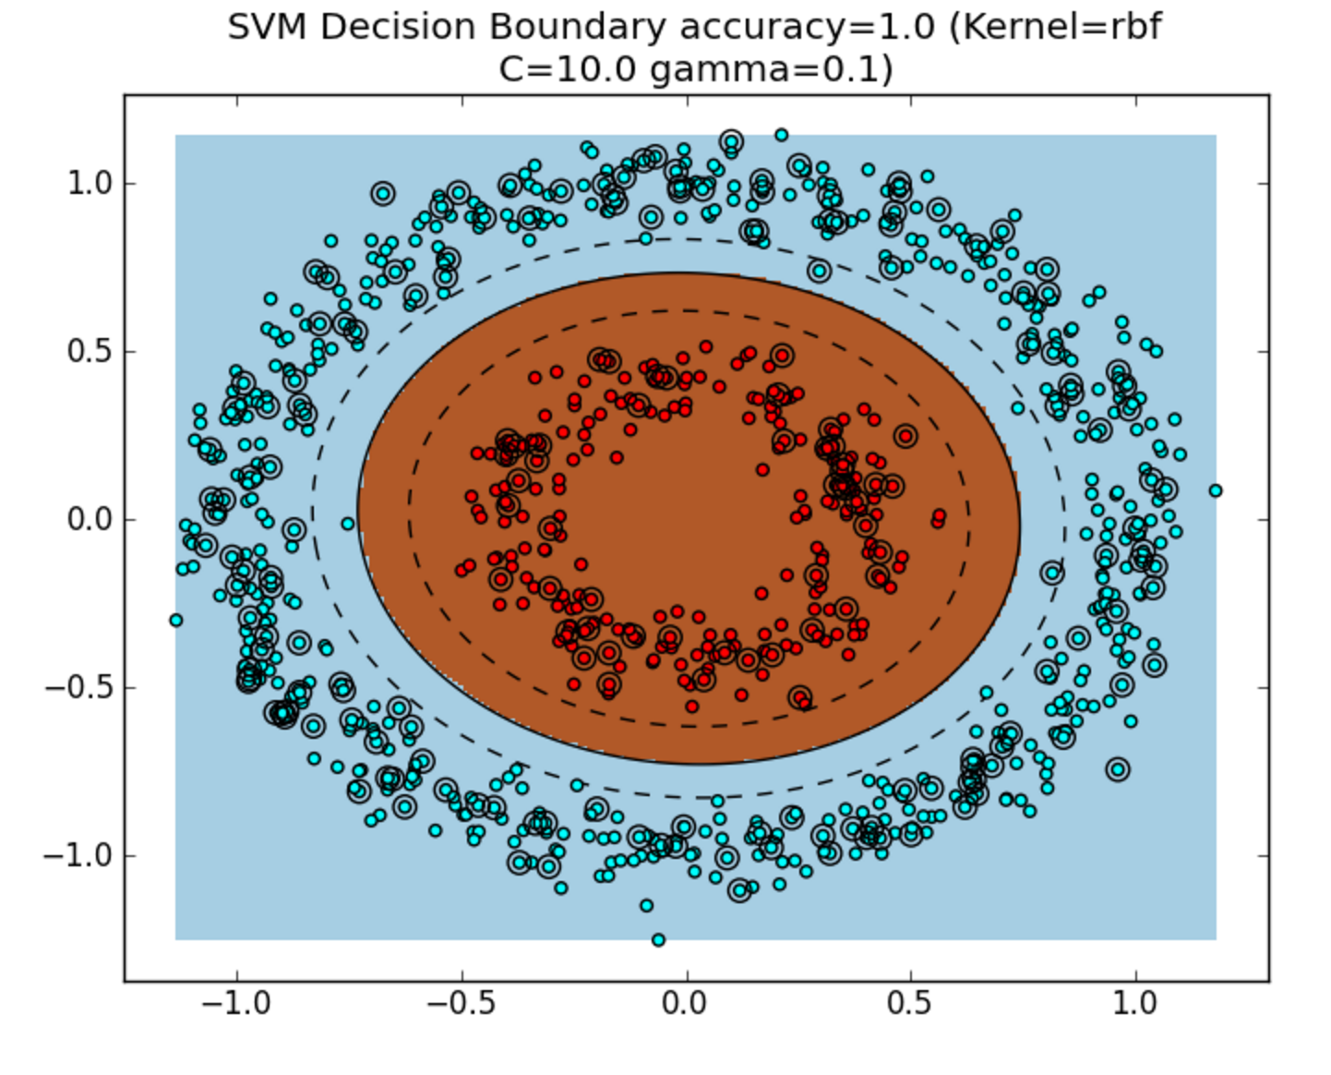
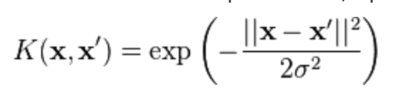
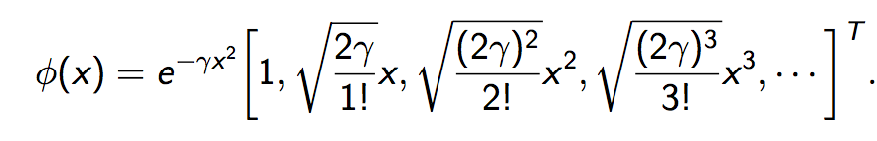
RBF Kernel: Aside
RBF is very popular kind of kernel, and is good with data that shows circular patterns.
The actual distance measure is:
Remember that K(x,y) = ϕ(x)^{T}ϕ(y)
So what is ϕ(x) in this case??
Turns out, ϕ(x) is actually projecting X into an infinite
dimensional space! Why using kernels is so much easier!

